Slide 1
Physics-Informed Reconstruction of Cylinder Flow with Reynolds Continuation
PINN-based reconstruction and transition analysis for 2D incompressible flow past a cylinder
Junhe Chen
Spring 2026

Slide 3
Project Overview
Physical problem, objectives, and expected transition behavior
Problem Statement
Main Deliverables
2D incompressible flow past a circular cylinder is a canonical benchmark in fluid dynamics.
As Reynolds number increases, the wake evolves from steady symmetric recirculation to time-periodic vortex shedding.
This project uses a Physics-Informed Neural Network (PINN) to reconstruct the flow field and study the transition region.
Flow reconstruction
Velocity, pressure, vorticity, and streamlines
Reusable pipeline
Continuation training across Reynolds numbers
Geometry and setup
Cylinder radius R = 0.5
Domain x in [-5, 25], y in [-10, 10]
Target Reynolds sweep: Re = 5 to 100

Slide 4
Governing Equations and PINN Formulation
2D incompressible Navier-Stokes with stream-function parameterization
Navier-Stokes Equations
Stream Function Form
u_t + u u_x + v u_y = -p_x + (1/Re)(u_xx + u_yy)
v_t + u v_x + v v_y = -p_y + (1/Re)(v_xx + v_yy)
u_x + v_y = 0
Represent the solution as
psi(x, y, t), p(x, y, t)
u = d psi / d y
v = - d psi / d x
The PINN minimizes PDE residuals together with boundary, initial, and outlet constraints using automatic differentiation.
Enforces incompressibility by construction.
Removes the need for an extra divergence penalty term.
Produces smooth derivatives compatible with PDE residual evaluation.

Slide 5
Network Architecture, Training, and Loss Design
Model Architecture
Loss Function
Sampling Strategy
(x, y, t) --> MLP --> (psi, p)
L = L_pde + 10 L_bc + 10 L_ic + L_out
Physics-aware collocation
Width
128 neurons/layer
PDE loss: momentum residuals from Navier-Stokes.
Boundary loss: inlet, wall, and far-field conditions.
Initial loss: uniform initialization in the domain.
Outlet loss: pressure / gradient regularization downstream.
50%
30%
20%
Depth
6 hidden layers
Refine points near the cylinder to capture boundary-layer behavior.
Bias sampling in the wake to resolve separation and shedding.
Use smoother activation and derivatives for stable AD-based training.
Activation
tanh
Optimizer
Adam + L-BFGS

Slide 6
Reynolds Continuation Strategy
Warm-starting across Reynolds numbers to improve optimization stability
Continuation Workflow
Re = 5
Re = 40
Re = 40-60
Re = 61-100
Initialize low-Re steady solution
Transfer weights and continue training
Resolve transition region carefully
Track increasingly unsteady wake dynamics
More stable optimization
Fewer iterations at each new Re
Better continuity across the parameter sweep

Slide 7
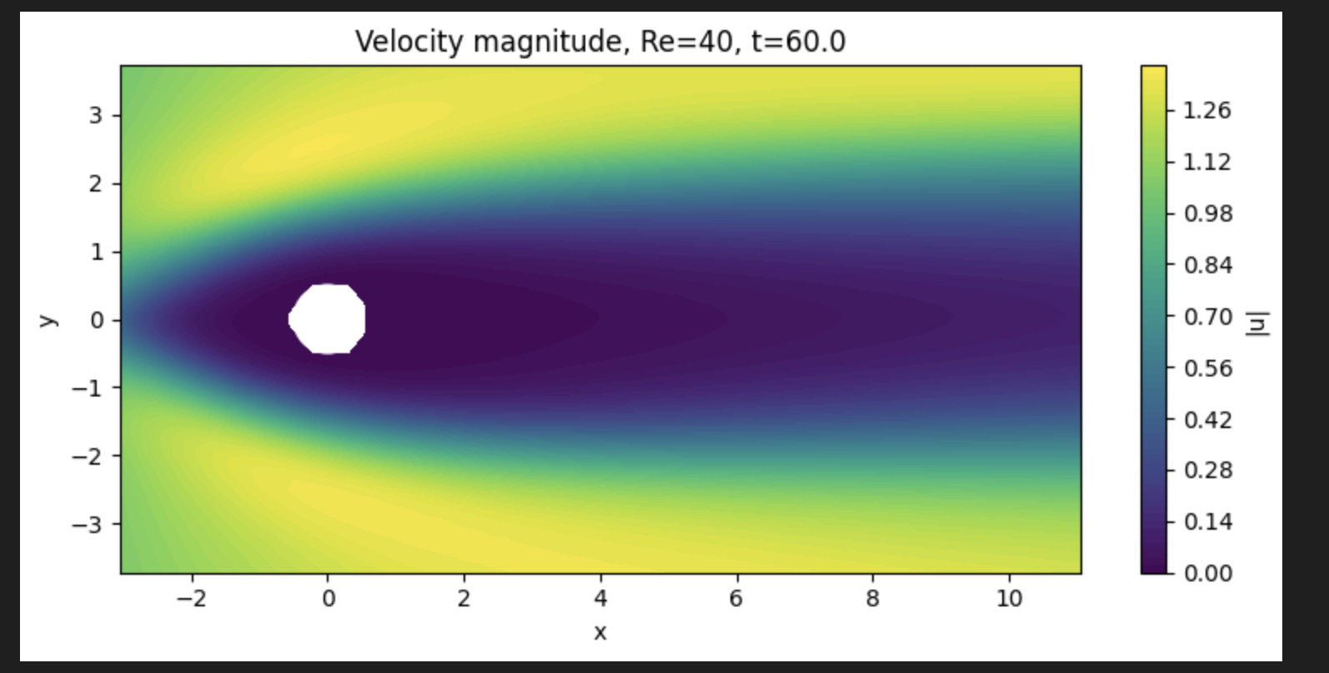
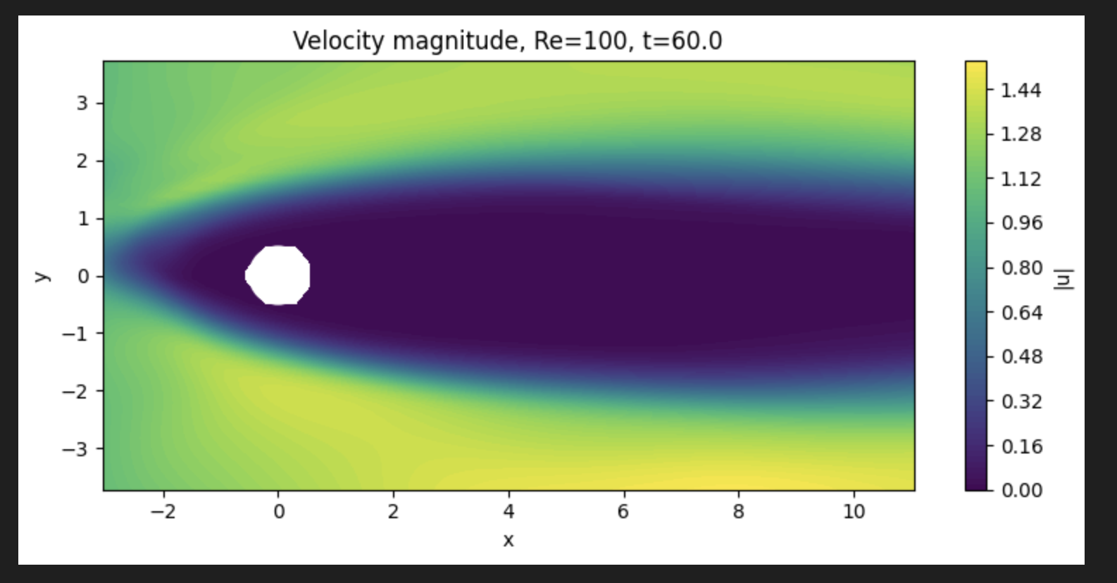
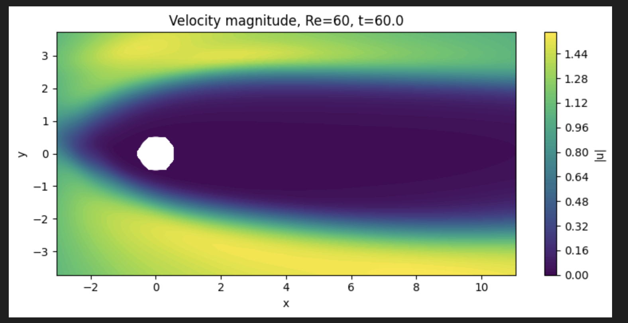
Results Placeholder: Flow Reconstruction
Replace placeholder panels with your exported figures
Key observations
Velocity magnitude should show stagnation at the front face and acceleration near the cylinder sides.
Downstream recovery and recirculation bubble length can be compared across Reynolds numbers.
Use the same colorbar range when comparing multiple Re values.
Recommended figures
• Velocity magnitude contour at representative times
• Streamline plot showing wake topology
• Optional comparison: Re = 40, 60, 100

Slide 10
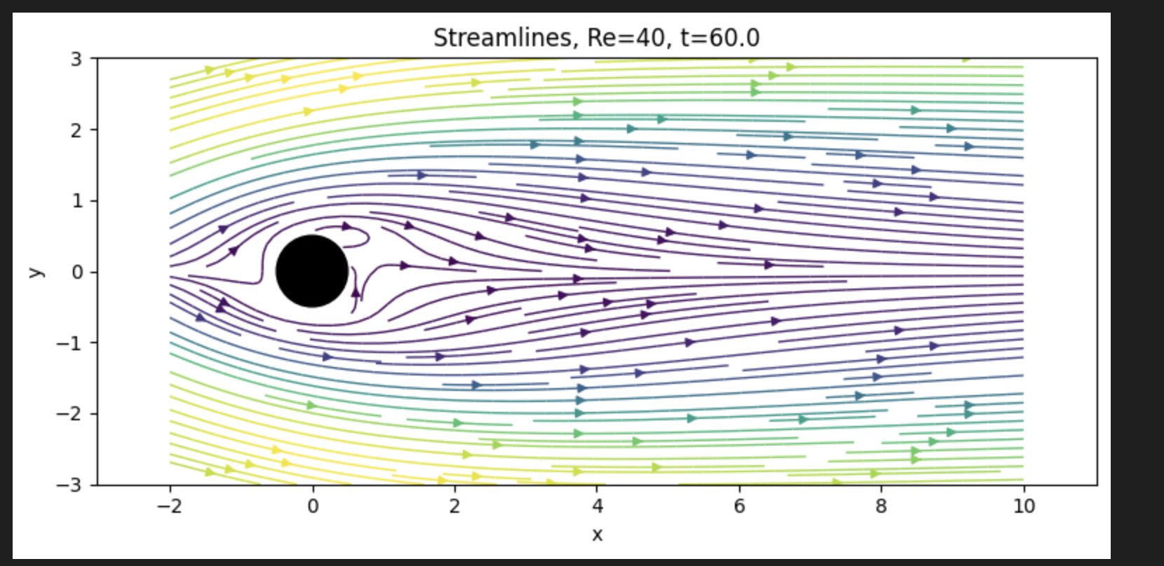

Slide 11
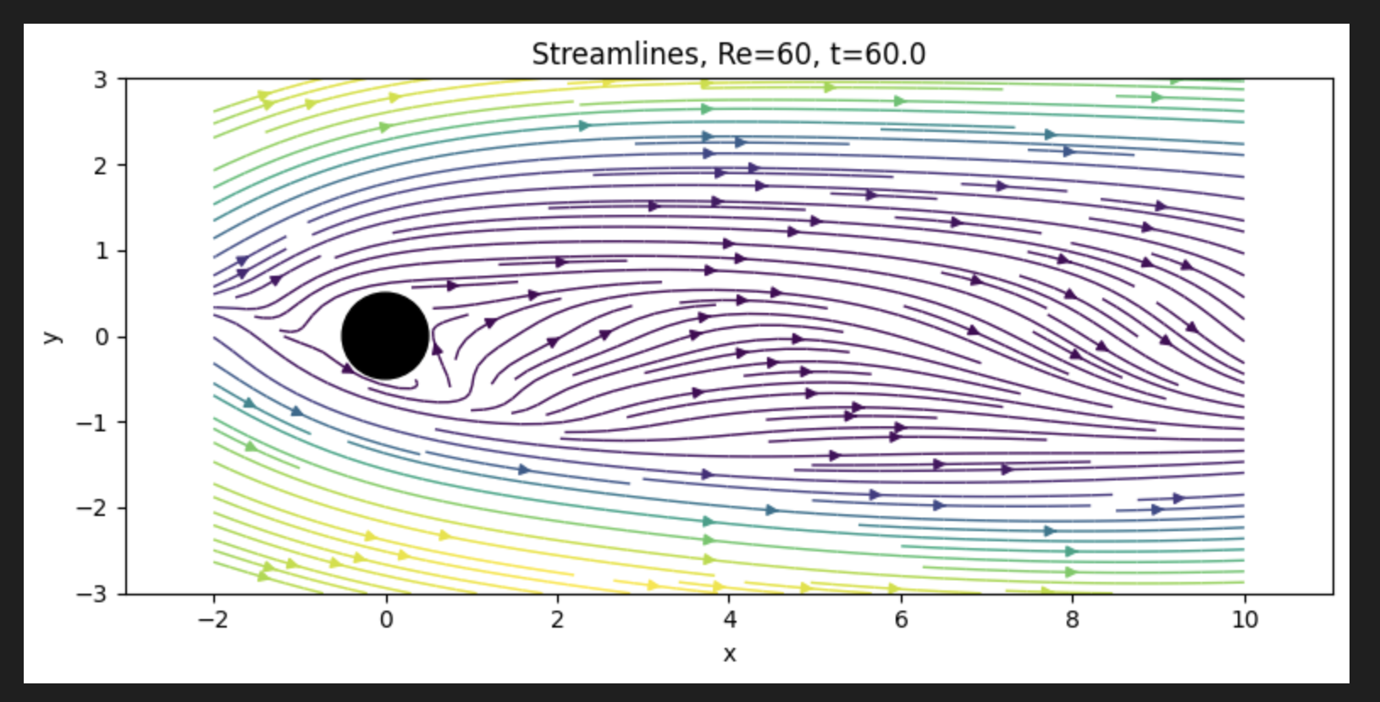

Slide 12
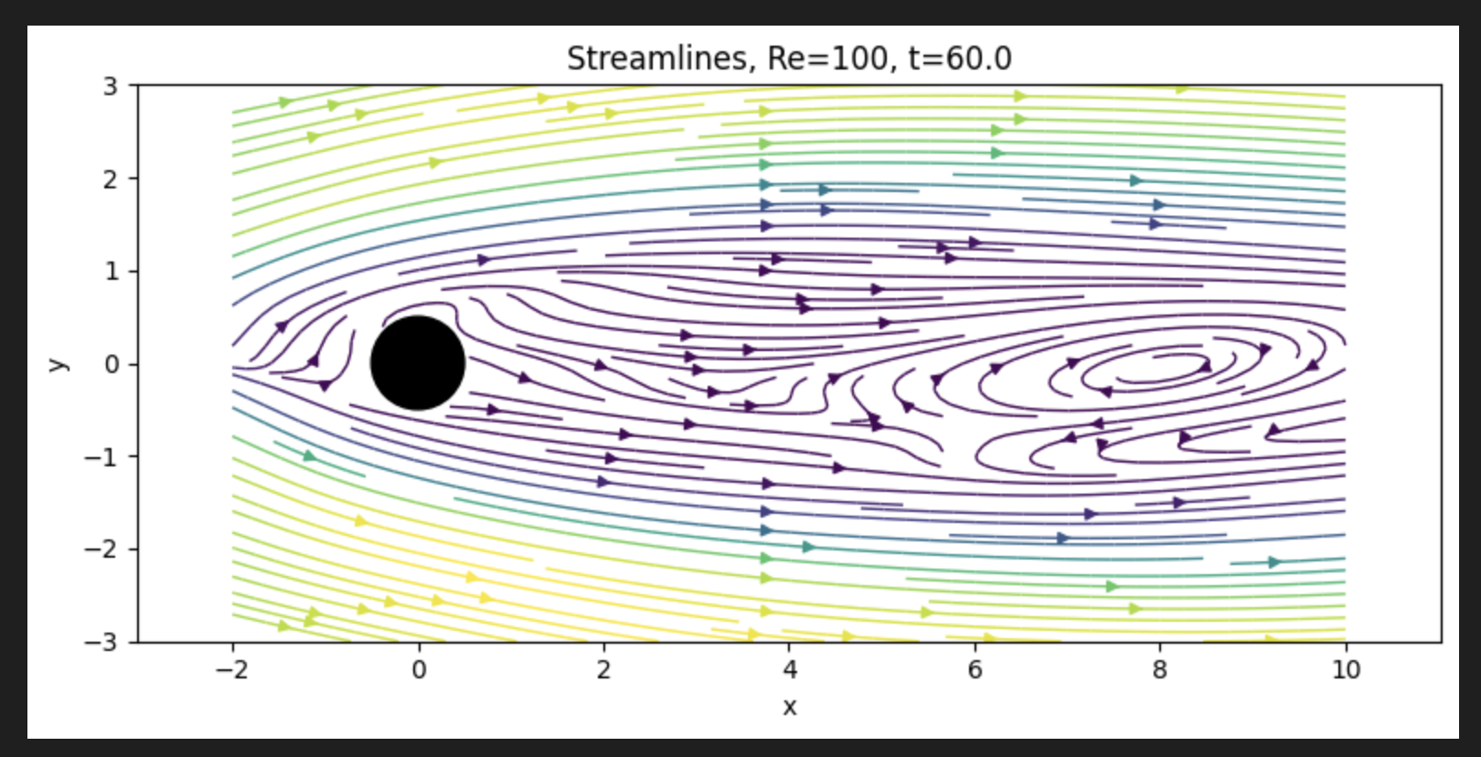

Slide 13
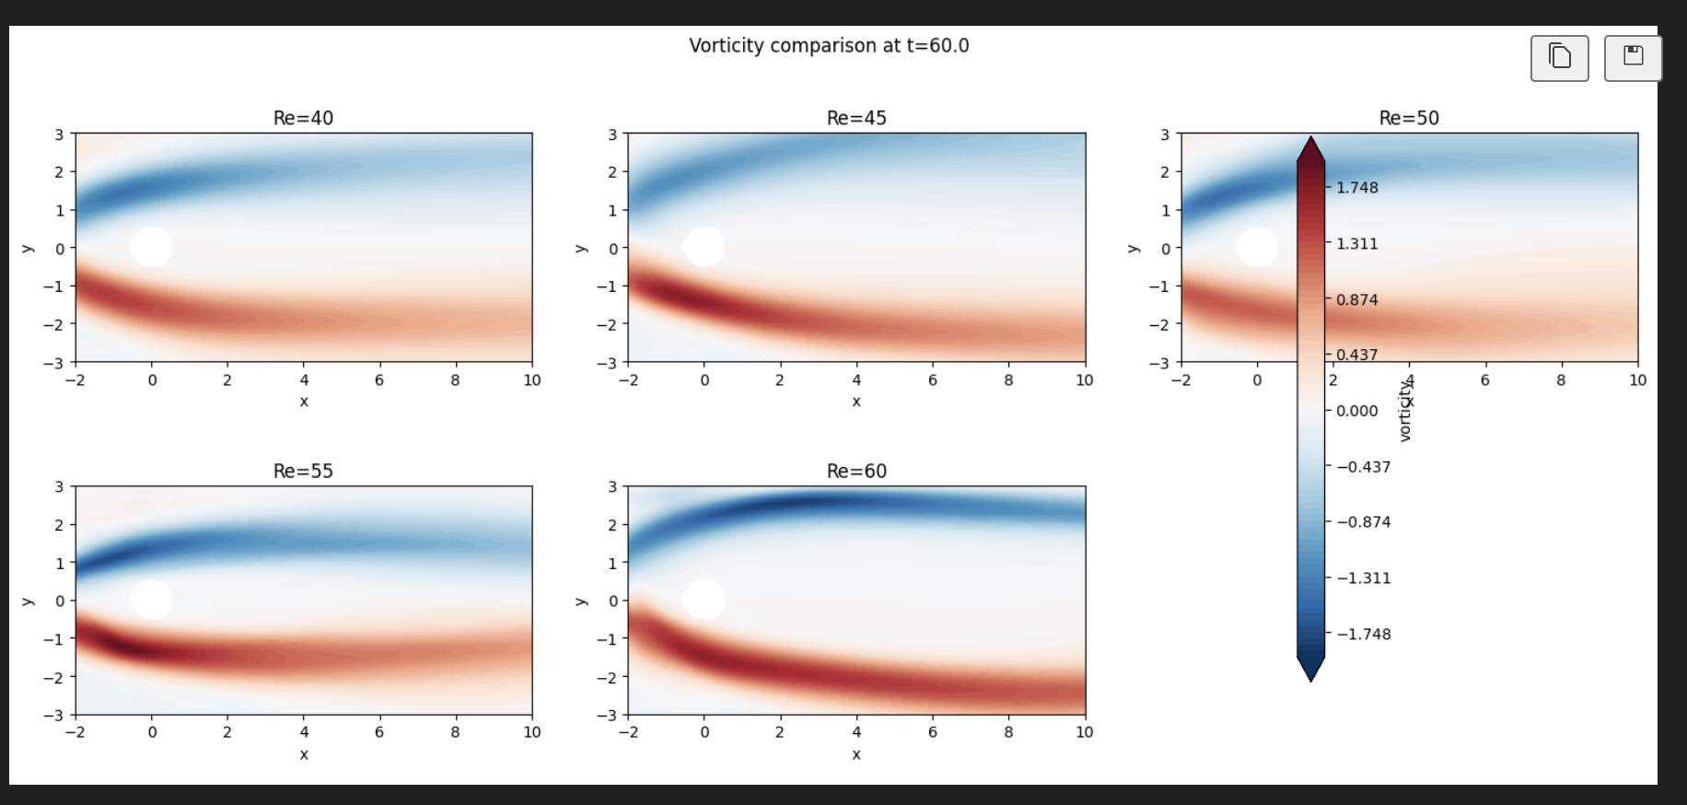
Results Placeholder: Vorticity and Probe Signals
Use these for wake structure and time-series evidence of transition

Slide 14
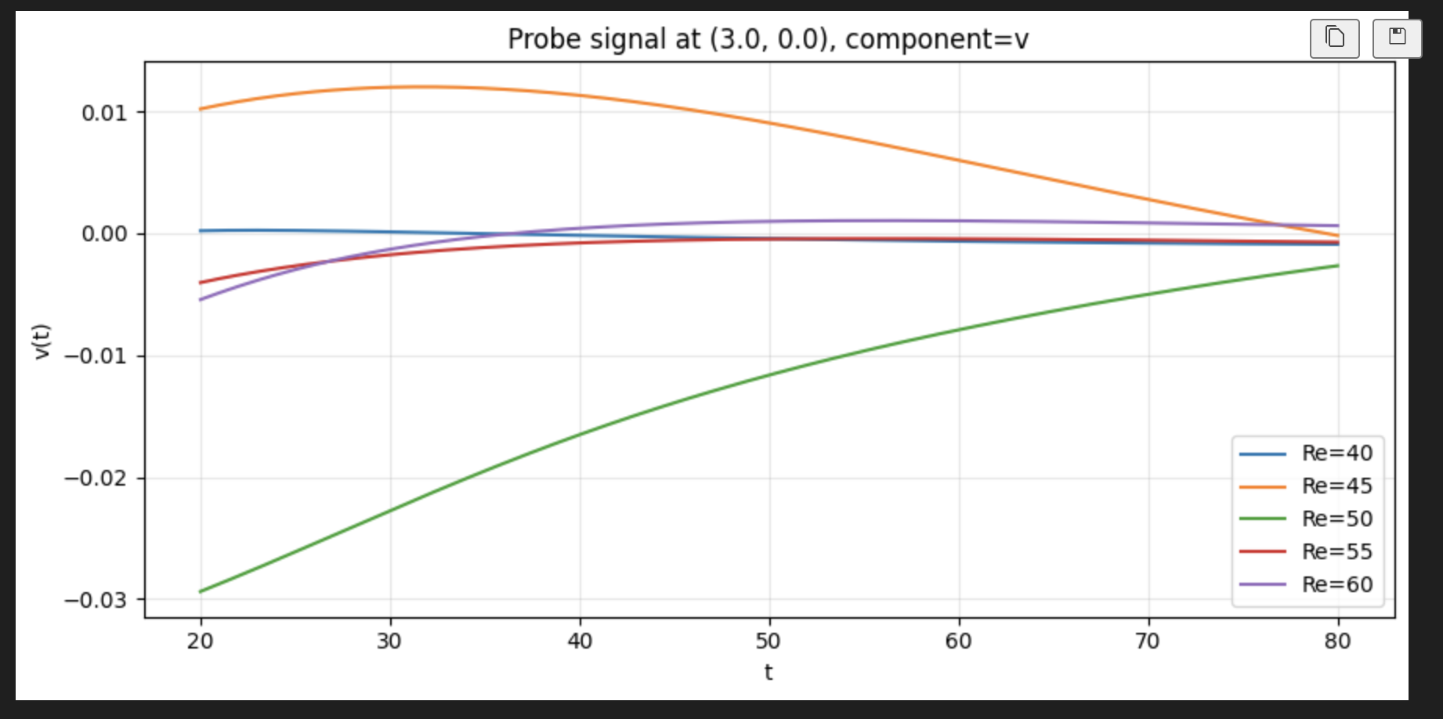

Slide 15
Run A — Sanity Configuration and Commands
Re=40 single-snapshot PINN, baseline domain and point counts
SLURM allocation + training command
Why these knobs (vs. previous run)
# 1) interactive GPU node
salloc -p gpu --gres=gpu:1 \
--mem=128G -t 12:00:00
# 2) Run A baseline training
python -u cfp40.py --vtk-path Re40.vtk \
--save-dir checkpoints_sanity_A \
--viz-dir viz_sanity_A \
--width 96 --depth 5 \
--epochs-adam 1500 \
--maxiter-bfgs 500 --iters-per-batch 100 \
--n-f 20000 --n-data 8000 \
--n-cfd-pde 4000 --lambda-pde-cfd 2.0 \
--cfd-pde-wall-buffer 0.5 \
--cfd-pde-edge-buffer 0.5 \
--x-min -3 --x-max 12 \
--y-min -4 --y-max 4 \
--method-bfgs SSBroyden1
Custom BFGS path fixed
Now actually invokes SSBroyden1 from
_optimize._minimize_bfgs. Old code passed
method_bfgs=… into scipy stock BFGS where
it was silently dropped → standard BFGS.
Frozen colloc + full data in BFGS
BFGS gets a deterministic objective; data
MSE can monotonically decrease.
CFD-PDE buffer = 0.5
Skips boundary-layer / far-field CFD
points where the CFD itself violates NS
(see CFD-PDE residual slide).
Memory budget check enabled
Aborts before Adam if H0 (NxN float64)
won't fit. 96/5: H0 ≈ 11 GB.
Junhe Chen | PINN Cylinder Flow Reconstruction
Brown University
8

Slide 16
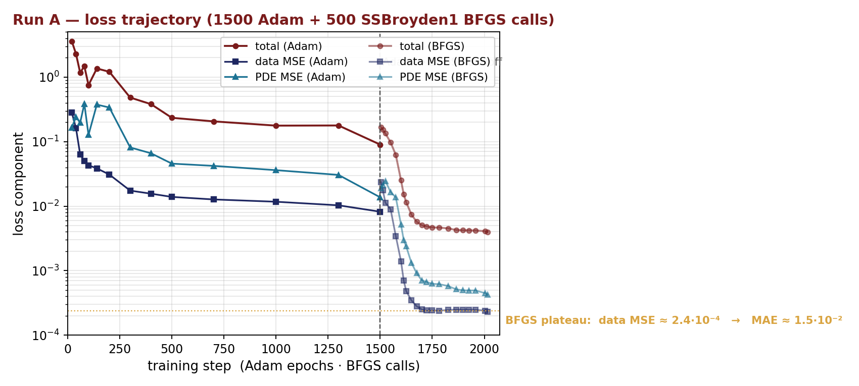
Run A — Loss Trajectory and Achieved Error
Adam (1500 ep) → SSBroyden1 BFGS (500 calls), data MSE drops 2 orders, then plateaus
Final-state summary
data MSE (BFGS plateau)
≈ 2.4 · 10⁻⁴
→ data MAE (per component)
≈ 1.5 · 10⁻²
Improvement vs. previous
MAE 6.3·10⁻² → 1.5·10⁻² (4×)
PDE colloc residual
MSE ≈ 4.3 · 10⁻⁴
L_wall_uv
≈ 3 · 10⁻¹⁵ (machine ε²)
Plateau cause
data and PDE balanced;
CFD itself has NS residual
≈ 1·10⁻³ (next slide)
DATA: 8.2·10⁻³ (Adam end) → 7.0·10⁻⁴ (BFGS batch 1) → 2.4·10⁻⁴ (BFGS batch 2, then plateau)
Junhe Chen | PINN Cylinder Flow Reconstruction
Brown University
9

Slide 17
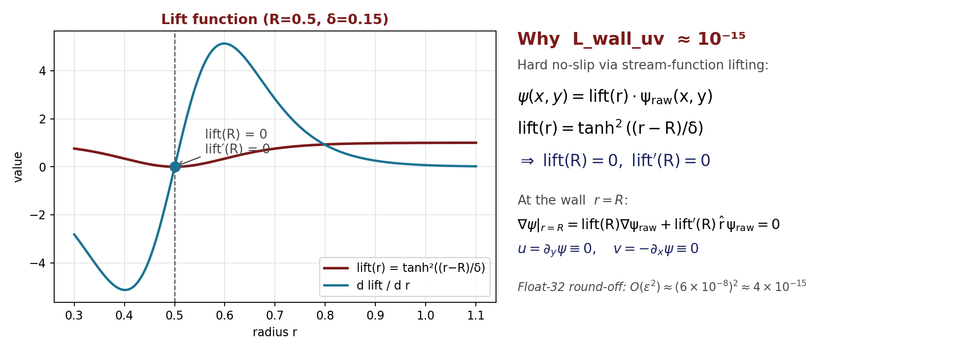
Hard No-Slip via Stream-Function Lifting
Why L_wall_uv saturates at machine ε² ≈ 10⁻¹⁵ instead of being optimised
From the lift conditions to ⟨u² + v²⟩ ≈ ε²
Define r(x,y) = √((x−x_c)² + (y−y_c)²), ψ = lift(r) · ψ_raw → ∇ψ = lift′(r)·r̂·ψ_raw + lift(r)·∇ψ_raw
lift(R) = tanh²(0) = 0, lift′(R) = 2 tanh(0) sech²(0) / δ = 0 ⇒ ∇ψ|_{r=R} = 0 ⇒ u = ∂_y ψ ≡ 0, v = −∂_x ψ ≡ 0 on the wall.
Numerically: fp32 unit round-off ε ≈ 6·10⁻⁸ on each velocity ⇒ L_wall_uv = ⟨u² + v²⟩ ~ ε² ≈ 4·10⁻¹⁵. Run-A measured ≈ 3·10⁻¹⁵ ✓
Junhe Chen | PINN Cylinder Flow Reconstruction
Brown University
10

Slide 18
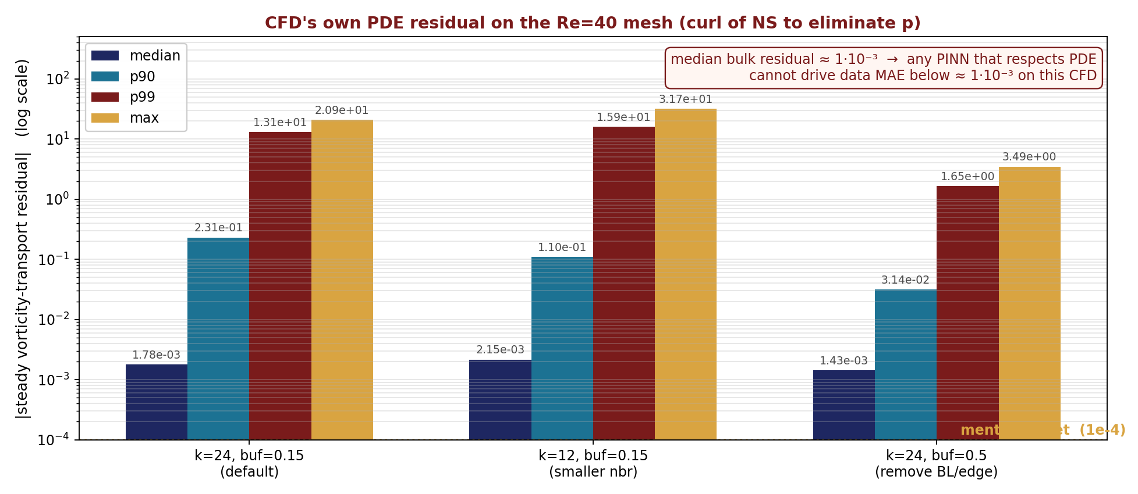
Is the CFD itself a solution of the PDE?
Steady vorticity-transport residual on the Re40 mesh — sets the achievable PINN floor
Method
On every interior CFD point:
(1) k-nearest neighbours,
(2) local quadratic fit to u and v,
(3) read u_x, u_y, ..., v_xy at center,
(4) ω = v_x − u_y,
(5) second fit for ω → ω_x, ω_y, ω_xx, ω_yy,
(6) compute r_ω = u·ω_x + v·ω_y
− (1/Re)(ω_xx + ω_yy).
Curl of momentum eliminates pressure
→ no need to know p from the VTK.
Three configurations tested:
• k=24, buf=0.15 (default)
• k=12, buf=0.15 (tighter neighbour fit)
• k=24, buf=0.5 (exclude BL + edge band)
Take-away: bulk CFD median NS residual ≈ 1·10⁻³ → 1e-4 ~ 1e-5 absolute MAE is NOT achievable while also satisfying the PDE on this mesh.
Junhe Chen | PINN Cylinder Flow Reconstruction
Brown University
11

Slide 19
Run A — Velocity Agreement on CFD Points
Per-component scatter and absolute error map (from run_analysis_re40.py)
Numbers (filled by analysis run)
mae_u, mae_v
→ summary.txt
rel_l2_u, rel_l2_v
→ summary.txt
Interpretation
Diagonal in scatter plot = perfect fit;
the error map highlights wake separation
and near-cylinder shear layer as the
regions PINN still struggles with.
Note: rel_l2_v looks large because
the true v field has small magnitude;
trust mae_v / max|ev| absolute numbers.
[ insert 01_velocity_scatter.png here after running run_analysis_re40.py ]
[ insert 02_velocity_error_map.png here after running run_analysis_re40.py ]
Junhe Chen | PINN Cylinder Flow Reconstruction
Brown University
12

Slide 20
Run A — PDE Residual on Collocation Points
Where PINN still violates Navier–Stokes after training
Compatibility check
pde_rmse_mag
→ summary.txt
near_cyl_pde_rmse_mag
vs far_pde_rmse_mag
→ summary.txt
Reading the map
Bright spots inside r=1 indicate
under-resolved boundary layer.
Bright spots in 1<x<5 indicate
under-resolved shear layers.
Compare to CFD's own residual
(slide 11): both are concentrated
at the same locations.
[ insert 03_pde_residual_map.png here after running run_analysis_re40.py ]
[ insert 04_pde_residual_hist.png here after running run_analysis_re40.py ]
Junhe Chen | PINN Cylinder Flow Reconstruction
Brown University
13

Slide 21
Run A — Boundary-Condition Diagnostics
Wall no-slip (hard-enforced), inlet, top/bottom (soft penalties)
[ insert 05_wall_noslip.png here after running run_analysis_re40.py ]
[ insert 06_inlet_topbottom.png here after running run_analysis_re40.py ]
Wall: max|u|, max|v| should be O(1e-7) — hard lift makes BC structural, not optimised (see slide 10). Inlet/top/bottom: rmse should be < 1e-2 after Adam→BFGS.
Junhe Chen | PINN Cylinder Flow Reconstruction
Brown University
14

Slide 22
Run A — Vorticity: PINN vs CFD
Derivative-level agreement: harder than velocity-level fit
[ insert 07_vorticity_cfd.png here after running run_analysis_re40.py ]
[ insert 07_vorticity_pinn.png here after running run_analysis_re40.py ]
[ insert 07_vorticity_diff.png here after running run_analysis_re40.py ]
What to look for
vort_rmse, vort_max_abs
→ summary.txt
Reading the panels
Top row: CFD (FD), PINN, error.
Bottom: VTK-derivative-based CFD
vorticity (more accurate, scattered).
Red/blue hot-spot pairs in error
→ small phase shift in the wake.
Acceptable; not a model-failure mode.
[ insert 07b_vorticity_cfd_vtk.png here after running run_analysis_re40.py ]
Junhe Chen | PINN Cylinder Flow Reconstruction
Brown University
15

